Slide 1
Standard Work

Slide 2
Welcome to Standard Work!
Introduction of Trainer(s)
Introduction of Team Member(s)

Slide 3
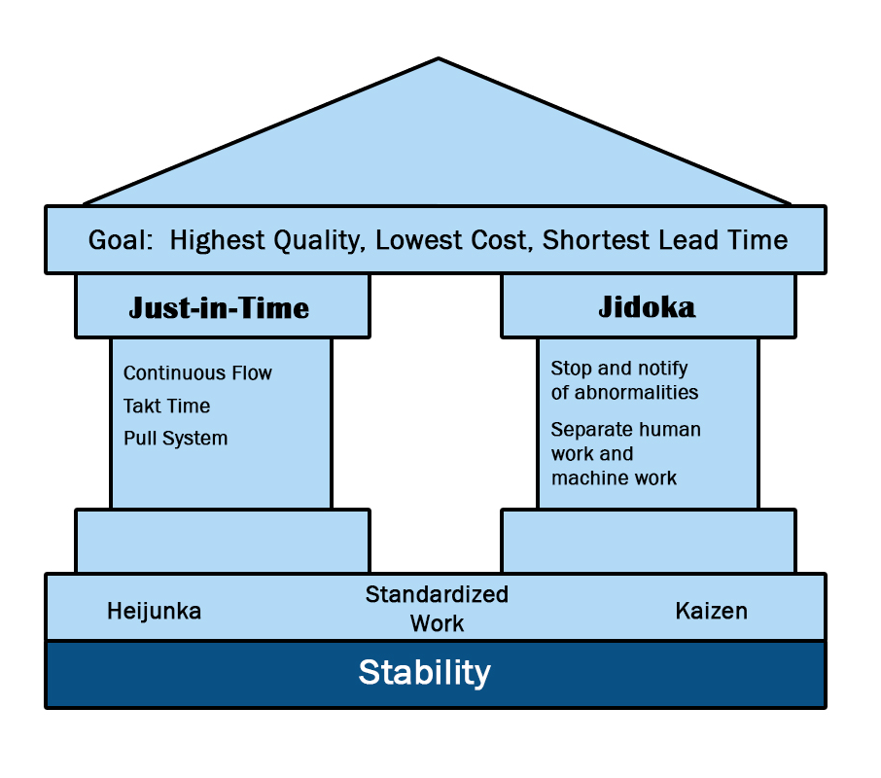
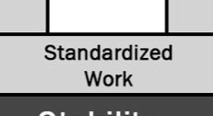
What is Standard work?
A tool used in lean manufacturing to optimize equipment and labor and producing product as a pace = Takt Time.
DO NOT think of standard work as traditional industrial engineering time standards
Based on benchmarking and improvements
NOT permanent
A documented, repeatable, step-for-step process for producing product
Notes:
Time Standards from a traditional I.E. standpoint involves timing a process and evaluating the efficiency of the operator and prorating accordingly. That assumes no improvements are needed. Standard Work sees Time Observation as a Starting Point in Kaizen. Change is necessary. Improvement is necessary.

Slide 4
Benefits of Standard Work
Establishes a routine/pattern for work to be performed.
Simplifies scheduling of human resources and material.
Establishes the necessary relationships between operators, machines, and materials.
A tool for documenting improvements.
A training tool for new employees.
Provides documented Work Instructions.

Slide 5
Lead-Time Strategy
Lean Manufacturing is a business strategy using lead-time as a tool to simultaneously improve:
  Quality
  Cost
  Delivery
Notes:
The number one metric for how competitive one company is over another is leadtime. Leadtime is a metric but it can be used as a tool to improve Quality Cost & Delivery. If we reduce the leadtime of a corrective action response being triggered from when the occurrence took place, there is a stronger connection in recalling what actually happened. We forget over time. Leadtime can be used to lower operating cost due to cashflow improvements, inventory reductions, etc. Leadtime reduction through a process provides a better chance for On Time Delivery to be met.

Slide 6
Product Lead-Time
2%
Traditional
Company
98%
Original
Lead-time
1%
Traditional
Improvement
Strategy
99%
Minor
Improvements
15%
“Lean”
Strategy
Major
Improvements
85%
Non-Value Added
Value Added
Notes:
Tradition thinking believes we need to decrease cycle times in order to reduce leadtime. However approx. only 2% of leadtime is value added. World Class metric is 30%. Since the majority of leadtime is NVA we should work on those instead.

Slide 7
Effects of “Batch” Manufacturing
Long lead times
Excess WIP/inventory
Creates waste
  Wait
  Travel
  Over Production, etc.
Resource consumption
  Handling
  Floor Space
  Associates
Increases chances for poor quality

Slide 8
“Lean” Attributes
Several Machines = One Operator
Multi-Skilled Work Force
Cellular Designed Layouts
One-Piece-Flow
Mixed Model Production
Production = Customer Demand

Slide 9
“Lean” Lead-Time
4 Minutes
Time: 1 2 3 4 5 6 7 8 9 10 11 12 13 14 15 16 17 18 19 20
Stamping
Sub-Assembly
Final Assembly
Testing
Lead-time is improved by reducing the lot size.
Notes:
If we assume each step takes 1 minute per part…..and we move in batches of 5…..it will take 20 minutes for the 1st piece to ready to move from Testing. If we move one piece after it is completed, the leadtime for that part is drastically reduced. Product waits on more product before moving in a batch environment.

Slide 10
3 Principles of “Lean” Manufacturing
Produce at a pace of Takt Time
Create material and operator Flow
Replenish material by Pull
Notes:
Shingijutsu Ltd teaches there are 3 principles in Lean…..Takt, Flow, and Pull.

Slide 11
Takt Time

Slide 12
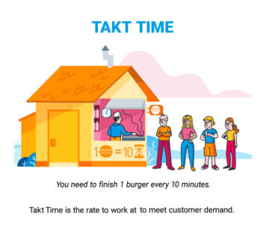

Takt Time (TT)
Purchasing of Material, Production of Components and Final Assemblies, & Delivery of Product, should occur at a pace known as “Takt TIME”.
“Takt” is a German word which means “beat” or “count”.
$$Takt Time=\frac{Total Time Available}{Customer Demand}$$

Slide 13
Production Smoothing
Customer Demand
Qty.
Avg. Daily Demand = Target Production
Time
Notes:
The red line is the true demand. It is not stable. There is not an industry or process that truly has a fixed constant demand. The blue is an average over time. By having a theoretical steady demand, we are able to simply resource scheduling. To react back and forth would not be feasible. A steady rate allows for Peaks to cover Valleys.

Slide 14

Takt Time Calculation
The pace we need to produce components or final assemblies to meet “Customer Demand”
Usually expressed as seconds per units
Takt Time and Cycle Time are typically NOT the same
$$Takt Time=\frac{Total Time Available}{Customer Demand}$$
Notes:
Takt Time is a very simple calculation. Sometimes it is taken lightly since it is so simple. However, it will affect every decision you make on your lean journey. It is important to take the time to calculate this.

Slide 15
Takt Time
Calculation
____ Hours Available/Shift = ____ Minutes Available / Shift
(minus) - ____ Minutes for Break Time
(minus) - ____ Minutes for Clean Up
(minus) - ____ Minutes for Other (Meetings, etc....)
TOTAL : ____ Available Minutes / Shift
or ____ Seconds / Shift
______ Seconds/Shift x ____ No. Shifts/Day = ______ Seconds / Day
Total Time Available Seconds
Takt Time = ------------------------------ = -----------
Customer Demand Piece
Notes:
In most processes the day is broken up in such a way that the process is intentionally not supposed to produce parts. Breaks, 5S, Communication Meetings. These are all valid reasons for a discrete process to stop. Continuous process run during these times and do not need to be subtracted.

Slide 16
Takt Time
Calculation
Company XYZ produces “widgets” for the airline industry
The plant runs 2 shifts per day x 5 days per week
Each shift has 2 x 15 minute breaks
Each shift has 15 minutes for cleanup at shift end
Each shift has a 10 minute kaizen meeting
Their customer requires 300 units per day
What is the “Takt Time”?

Slide 17
Takt Time
Calculation
____ Hours Available/Shift = ____ Minutes Available / Shift
(minus) - ____ Minutes for Break Time
(minus) - ____ Minutes for Clean Up
(minus) - ____ Minutes for Other (Meetings, etc....)
TOTAL : ____ Available Minutes / Shift
or ____ Seconds / Shift
______ Seconds/Shift x ____ No. Shifts/Day = ______ Seconds / Day
Total Time Available Seconds
Takt Time = ------------------------------ = -----------
Customer Demand Piece

Slide 18
Takt Time
Calculation
480
30
15
10
425
25,000
8 Hours Available/Shift = ____ Minutes Available / Shift
(minus) - ____ Minutes for Break Time
(minus) - ____ Minutes for Clean Up
(minus) - ____ Minutes for Other (Meetings, etc....)
TOTAL : ____ Available Minutes / Shift
or ______ Seconds / Shift
______ Seconds/Shift x ____ No. Shifts/Day = ______ Seconds / Day
Total Time Available Seconds 51,000 sec 170 sec
Takt Time = ------------------------------ = ----------- = ---------------- = -----------
Customer Demand Unit 300 units unit
25,000
2
51,000
Notes:
We typically calculate the math for 1 shift and then multiply if additional shifts are utilized. It is possible for some departments to have different available times than others.

Slide 19
Takt Time: Key Points
Establishing Takt Time is essential for establishing a lean manufacturing environment
Takt Time is not decided on the “production floor,” it is decided in the “office”
Takt is the pace we need to produce parts in order to meet customer demands
We must re-calculate Takt Time when there is a change in customer demand or the time available to produce the demand
$$Takt Time=\frac{Total Time Available}{Customer Demand}$$

Slide 20
Flow

Slide 21
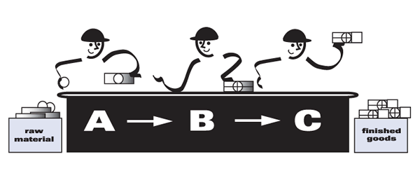
Flow
Material and operators need to flow, continuously, from raw material to finished goods
Manufacturing cells must support the idea of “one-piece-flow”
Standard work in process should be used to maintain flow
Flow should be from raw material to finished goods
Manufacturing cells must follow “STANDARD WORK”
Flow should be right to left or “counterclockwise”

Slide 22
Material and Operator Flow
5
5
4
4
3
3
2
2
1
1
Raw
3
2
1
2
1
4
5
6
3
4
6
Finished
Goods
6
7
7
8
8
9
9
10

Slide 23
Pull

Slide 24
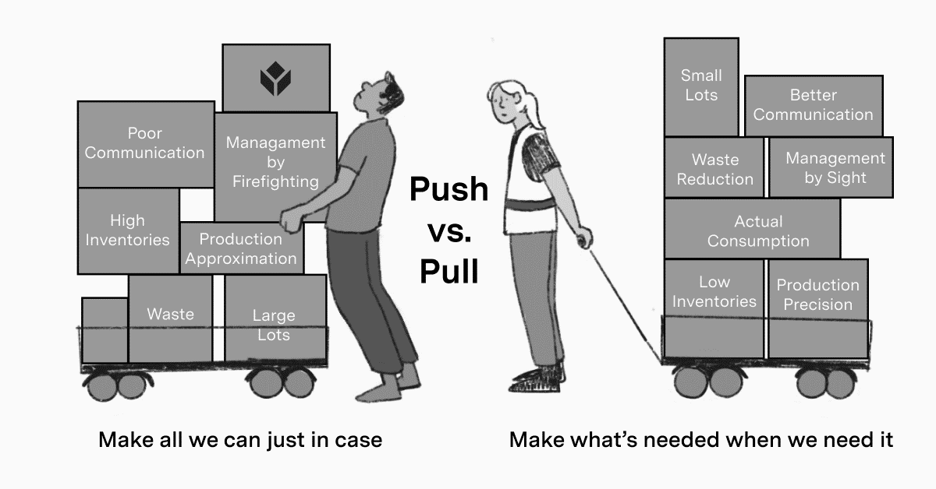
Pull
Material should be “pulled” through a cell, not “pushed”
Product should be built by demand, NOT FORECAST
Components production from feeder cells or monuments should be triggered by consumption; Kanban cards

Slide 25
Push VS Pull
Over Production
Waiting
X
“PUSH” not allowed
“Pull” is Correct
Notes:
If we continue to build products and part of the value stream has stopped, maybe due to a breakdown or quality issue, the WIP will continue to build, thus Over Production is occurring. Pull Systems regulate the WIP in between process. If a process stops downstream, the processes feeding it will stop soon after, automatically.

Slide 26
Standard Work

Slide 27
Introduction to Standard Work
Time Observation Form
Process Capacity Table
Standard Work Combination Sheet
Standard Work Sheet
Operator Loading Chart

Slide 28
Standard Work
A tool used in lean manufacturing to optimize equipment and labor and producing product at a pace = Takt Time.
DO NOT think of Standard Work as traditional Industrial Engineering time standards.
Based on benchmarking and improvements
NOT permanent
A documented, repeatable, step for step process for producing product.

Slide 29
Benefits of Standard Work
Establishes a routine/pattern for work to be performed
Simplifies scheduling of human resources and material
Establishes the necessary relationship between operators, machines, and materials
A tool for documenting improvement
A training tool for new employees
Provides documented work instructions

Slide 30
Standard work Forms
Time Observation Form
Process Capacity Table
Standard Work Combination Sheet
Standard Work Sheet
Operator Loading Chart
Notes:
These are the 5 forms used for Standard Work. The time observation form is for timing the process steps involved for operators. The process capacity table is used to amortize perishable tool wear over affected quantities to adjust the automatic machine times and capacity being utilized. The standard work combination sheet combines the operator times, walking times, and machine cycle times into 1 visual chart. The Standard Work Sheet shows an aerial view of a process to indicate the general path of the operator during the process cycle. The operator loading chart is used to show how work is divided among multiple operators and how they compare to each other and more importantly …takt time.

Slide 31
Time Observation Form
One sheet per operator
Concentrated on manual and walk time elements
Three key steps:
  Identify work elements
  Determine observation points
  Time each element with a running clock
Use as benchmark for further improvements

Slide 32
Time Observation Form Example

Slide 33
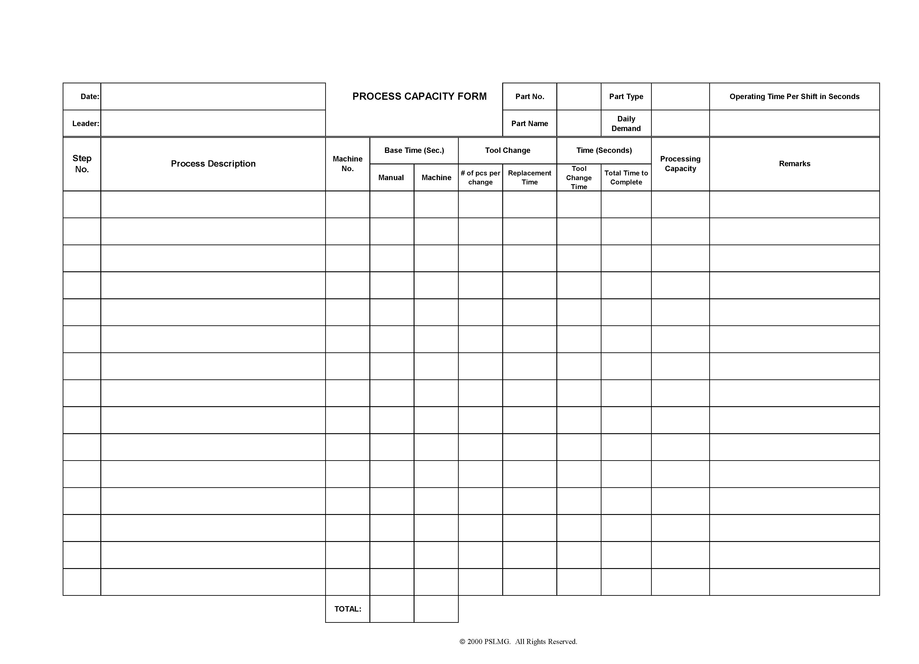
Process Capacity Table
One sheet per cell
Documents machine capacity per shift
Focuses on total machine time including “load/unload”
Apportions tool change time
Do not include abnormalities
Used as benchmark for further improvements

Slide 34
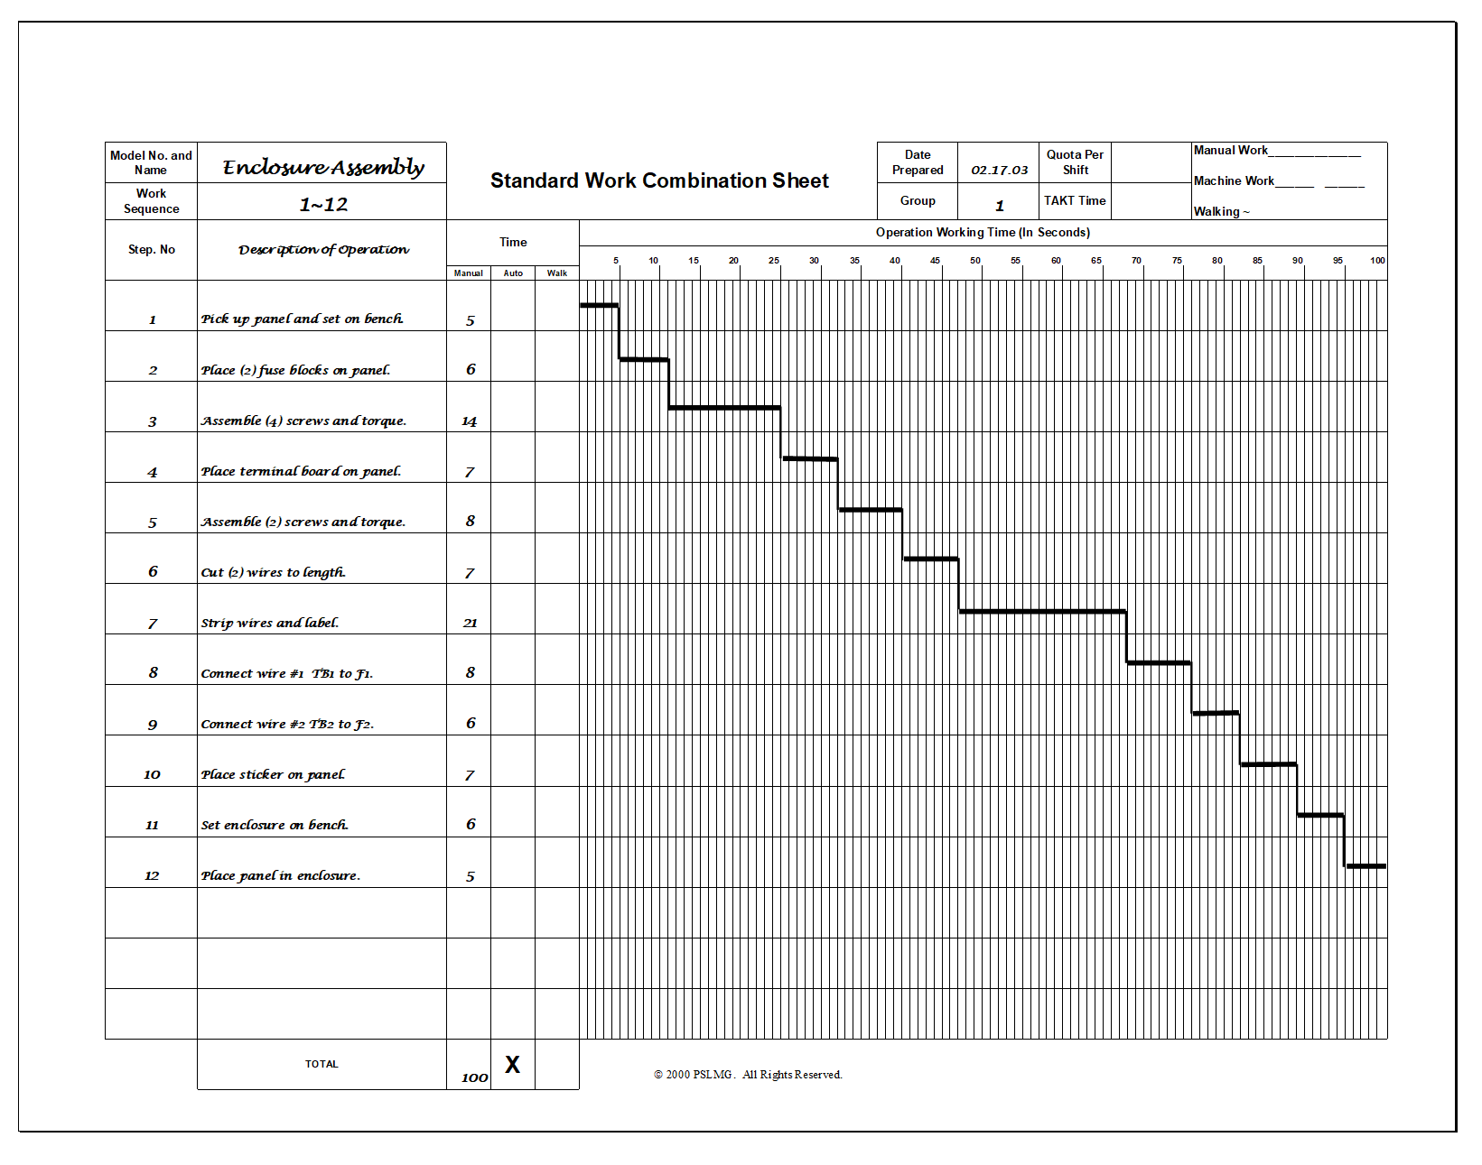
Standard Work Combination Sheet Example
Notes:
The ghant chart is used to show visually how the cycle times cascade into the total time. This chart shows manual effort, walking, and machine cycle times if automatic. When dividing work between operators, no person should have more than the amount of the Takt Time. In most cases, the steps cannot be split. So when dividing work you must go back to the end of the revious step when defining work load.

Slide 35
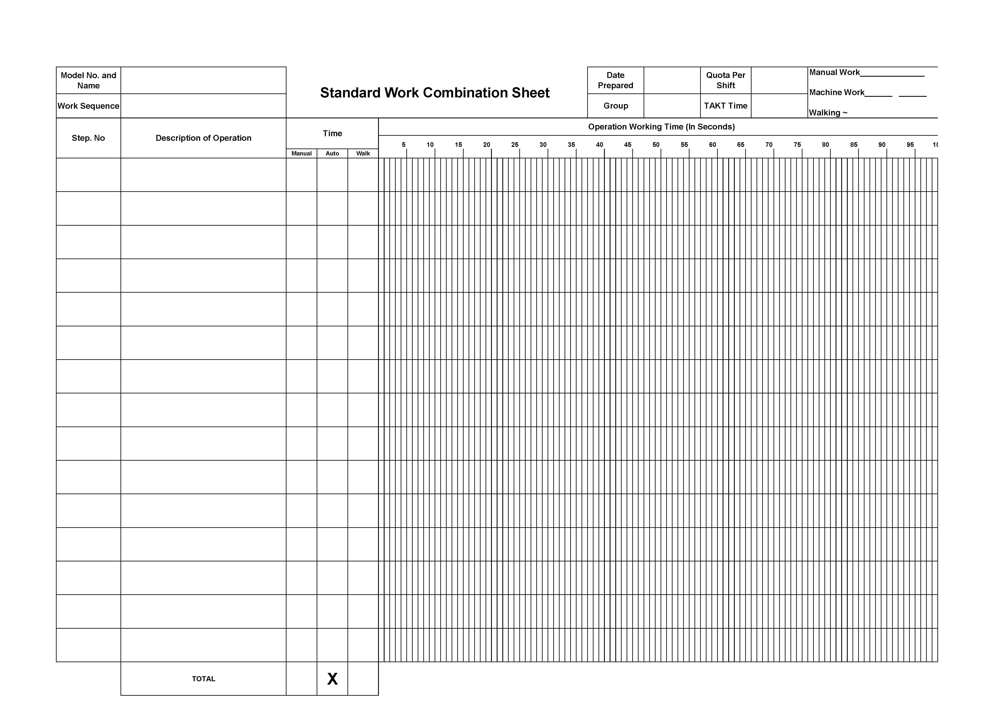
Standard Work Combination Sheet
One sheet per operator
Combines manual, automatic machine, & walk elements
Plotted against Takt time
Post at start point of each operator sequence

Slide 36
Process Capacity Table Example
Notes:
This chart is used to amortize a tool wear change over the cycles that it covers. I.e., change a tool every 100 pcs and it take 6:00, or 360 seconds……allocate 3.6 seconds per piece. This is for calculating capacity of a process when it is running. Note: this does not include changeovers, nor pm’s.

Slide 37
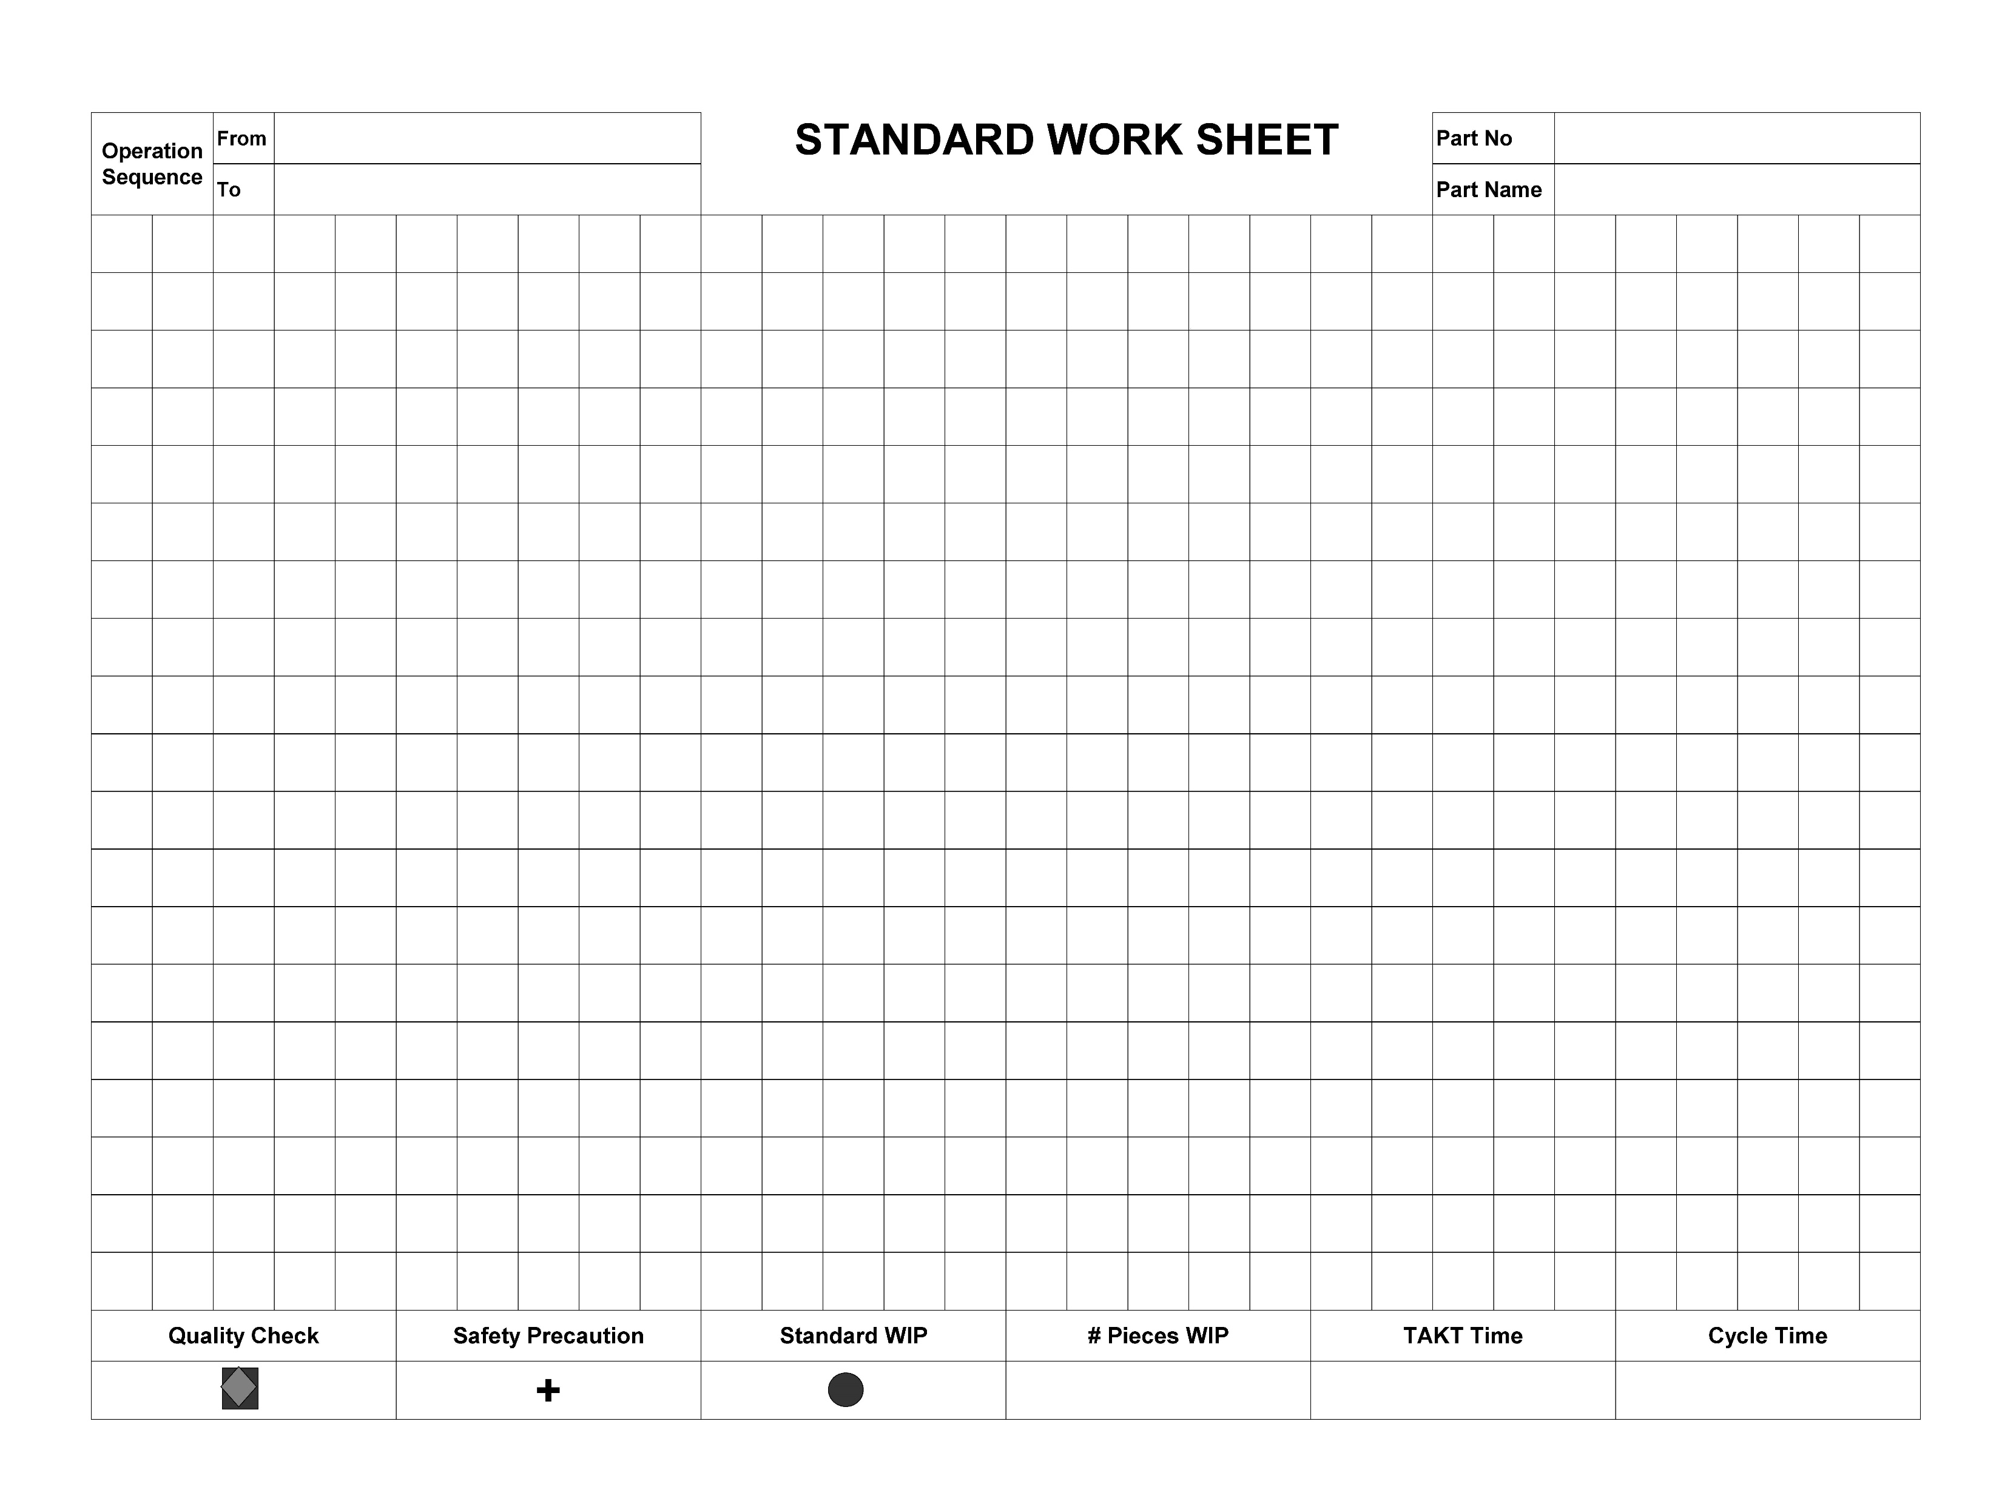
Standard Work Layout Sheet
One sheet per operator
Overhead view of cell
Shows processes and work sequence
Documents:
  Standard WIP
  Safety precautions
  Quality checks

Slide 38
Standard Work Layout Sheet Example
Notes:
This chart is the Standard Work Layout Sheet. It is aerial sketch to give perspective of the flow of the operator work path. It does not have to be a perfect scale but close is preferred. It shows where quality checks occur, where safety precaution needs attention, maybe heat, or electrical testing. It also shows the standard WIP (work in process) that should always be present. If a leader walks up and there is more or less, we know standard work is not being followed.

Slide 39
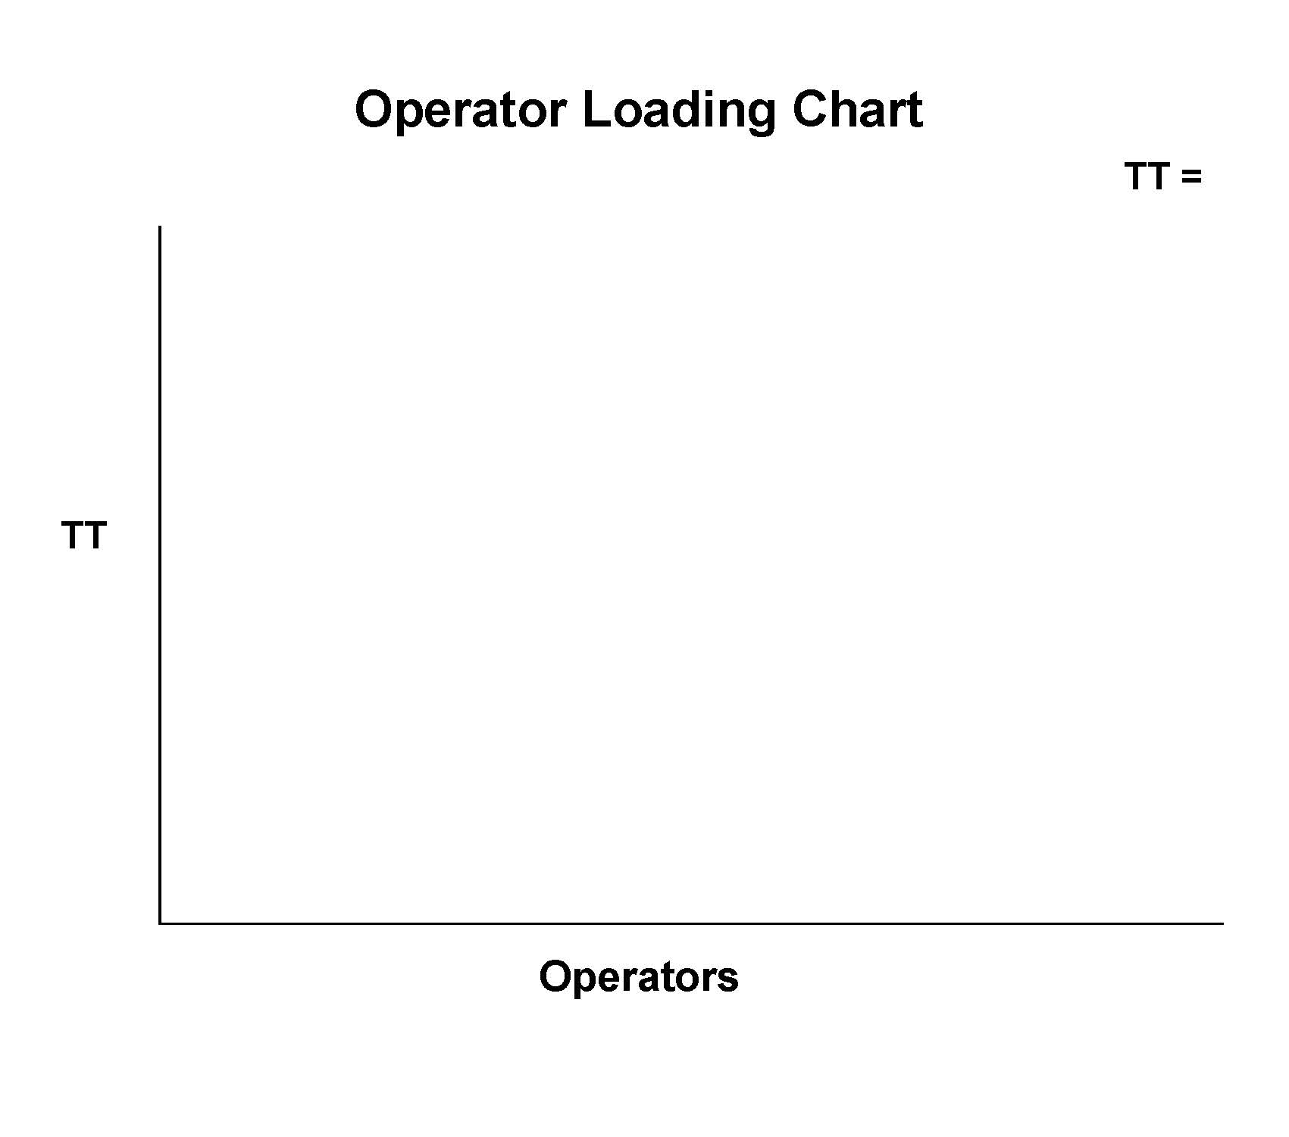
Operator Loading Chart
Documents time allocated to each operator in a cell
Documents how many operators are required in a cell
Shown as a bar chart
Post at beginning of cell

Slide 40
Operator Loading Chart Example
Notes:
This is the Operator Loading Chart. It is more common for this to be uneven than even. In fact, it is almost impossible to fully balance a line equal. KEY POINT. There will always be a station or person that has slightly more time than the balance of the operators. This step is the Time Trap. (The step that takes the longest). This step dictates the output of a process. Every process has a Time Trap.

Slide 41
Traditional Line Balancing
TT =
TT
1 2 3 4
Operators
Notes:
This is tradition thinking and traditional line balancing. This is most likely not going to happen.

Slide 42
Lean Manufacturing Balancing
TT =
TT
“Least Man”
1 2 3 4
Operators
Notes:
However, it is possible to perfectly balance the line,, it is best to load up to no more than 90% of the takt time. The least man operator concept, is preferred. This person can do the NVA activities such as move product away or backfill bins on the line.

Slide 43
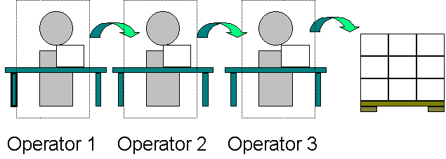
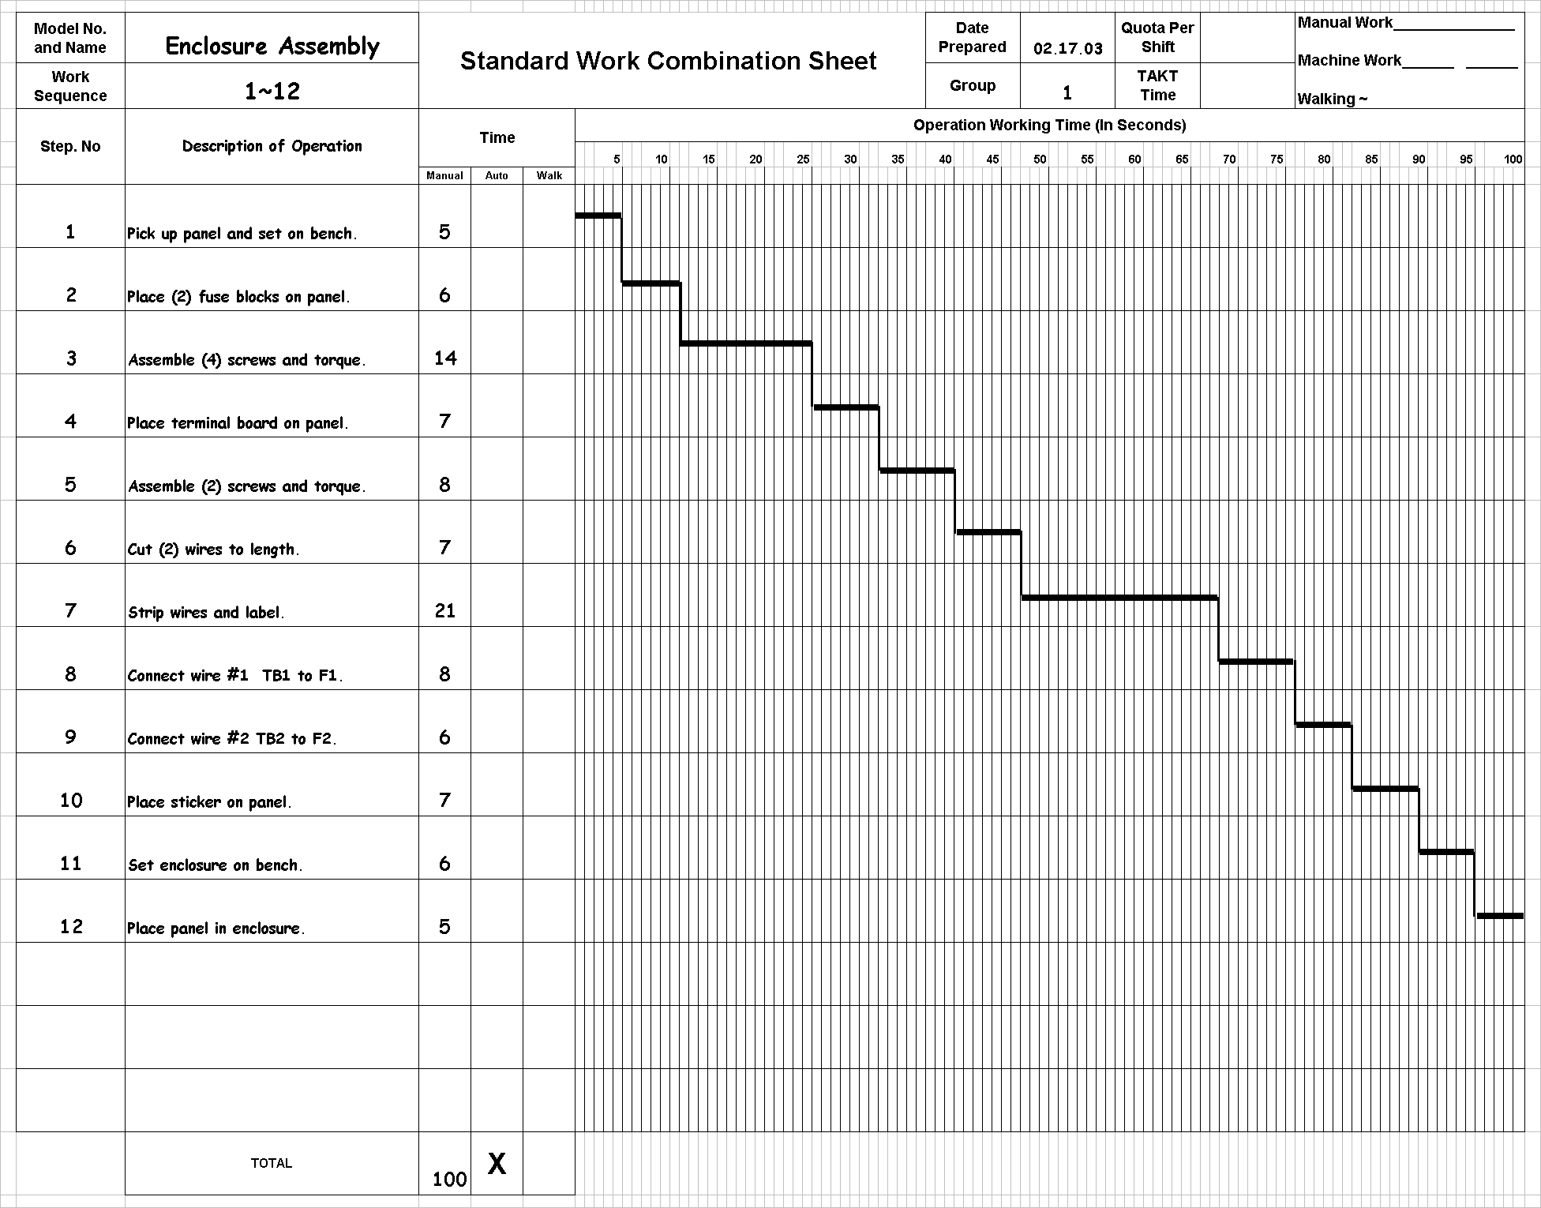
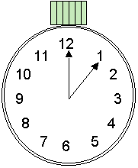
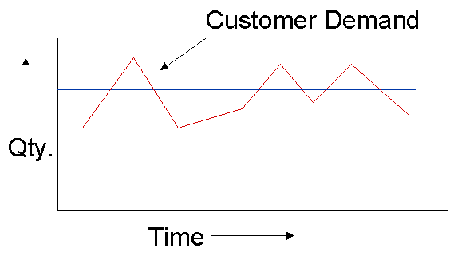
Managing with Standard Work

Slide 44
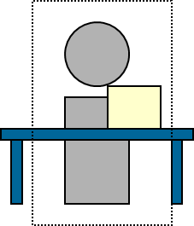
Demand Determines Number of Operators
As Takt time changes, what is it that needs to change to meet the new production requirements?
The number of people, or the amount of labor!!

Slide 45
Normal Production Demand
Operator 1 Operator 2 Operator 3
Note: Standard Work Followed

Slide 46
Increased Production Demand
Operator 1 Operator 3 Operator 5
Operator 2 Operator 4
Note: The Standard Work, or work content and sequence is still the same!!!

Slide 47
Decreased Production Demand
Operator 1 Operator 2
Note: The Standard Work, or work content and sequence is still the same!!

Slide 48
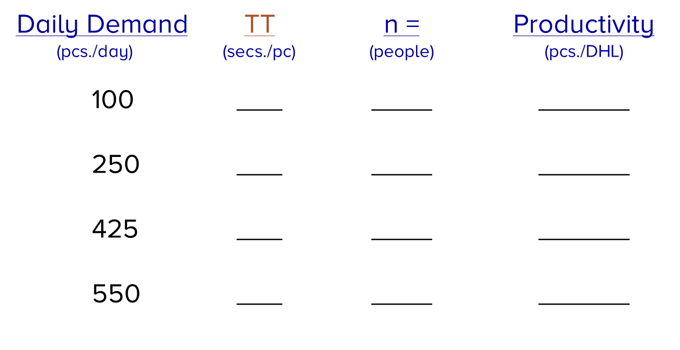
Exercise
Managing with Standard Work
Company XYZ Electronics is beginning a new product line called “Enclosure Assembly”. From the projected demands, determine:
Number of people required to run the new cell
How to separate the work content for each person
Calculate the productivity for each condition
Notes:
Calculate Takt Time with the given demand. Divide the work up so that nobody has more than takt time keeping in mind a step cannot be split. Calculate the number of people required for each scenario. Based on the TimeTrap scenario, what is the output of the cell, how many people were used, what is the Productivity of the cell?

