Slide 1
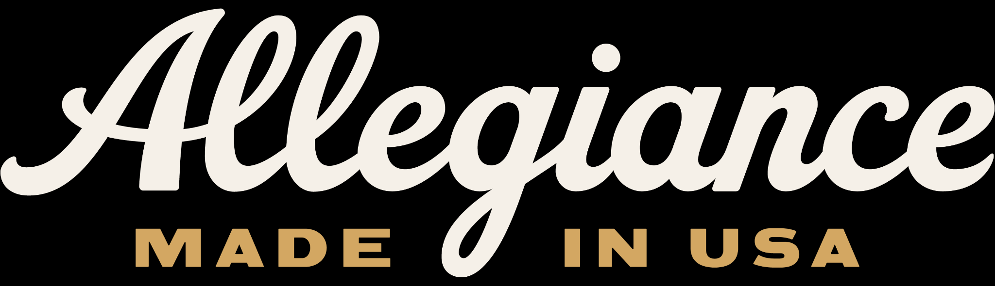
Allegiance Flag Supply Workflow transformation
HOW OPEN AI HELPED TRANSFORM OUR PRODUCTION MODEL

Slide 2
From a Charleston Garage to America’s Premium Flag Maker
Allegiance Flag Supply was born out of a simple frustration. When co-founders Wes Lyon, Katie Lyon and Max Berry purchased their first homes in Charleston, SC, they set out to fly the American flag with pride — only to find that every flag they bought deteriorated within months and nearly all were manufactured overseas. The American flag, of all things, wasn’t being made in America.
Driven by that discovery, the three co-founders launched Allegiance in 2018 from the Lyons’ garage in Charleston’s Avondale neighborhood. Their mission: craft a genuinely premium, 100% American-made flag from materials sourced domestically to every stitch sewn by hand on U.S. soil.
Today, Allegiance operates out of a 31,000 sq/ft manufacturing facility in North Charleston and ships more than 2,000 flags daily to customers across the country and to U.S. military bases abroad. With more expansion plans underway and plans to grow to 130+, the company is also proudly restoring textile jobs to South Carolina, a state with deep manufacturing roots.

Slide 3
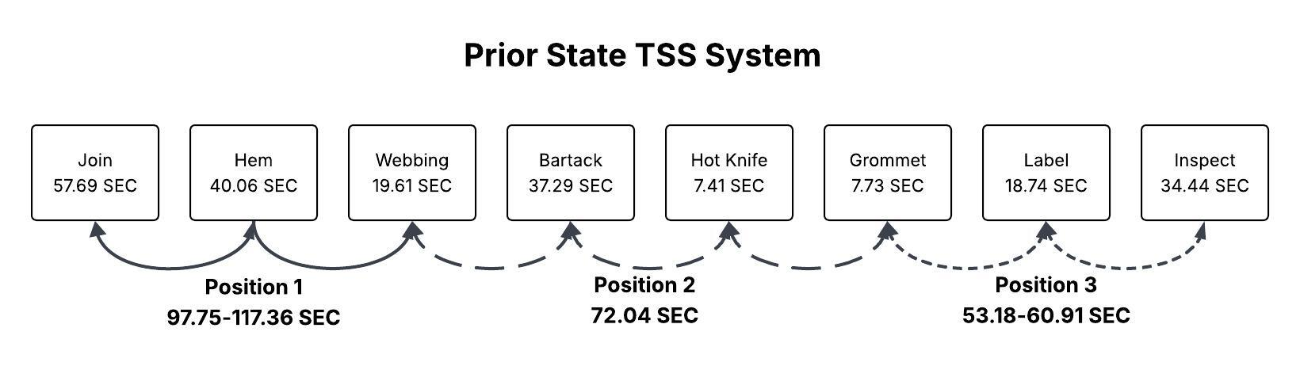
Previous production system
We were utilizing a system called the TSS (Toyota Sewing System) in which 3 operators would execute the “bump” operation when the product was finished. There was no defined role in each position. They could perform as many as 6 operations depending on how the line was performing at any given time. We understood that the front of the line was very labor heavy based on this production model. The operators described their fatigue with this process so we knew that we had to rebalance the system.

Slide 4
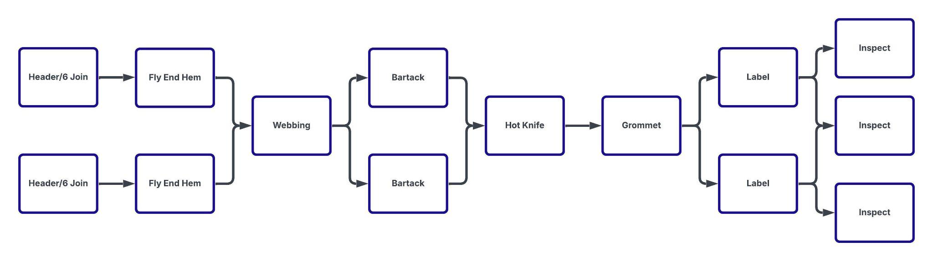
Attempting to balance the line
Our initial thought was to add machinery based on the time studies that we collected to attempt to balance the line for each operation. We could not get the labor times to balance with the headcount to improve production based on the ratio of flags made to production employees. There always seemed to be a bottleneck somewhere in the production process. This is where we started using AI by uploading all of our data that we had been collecting.

Slide 5
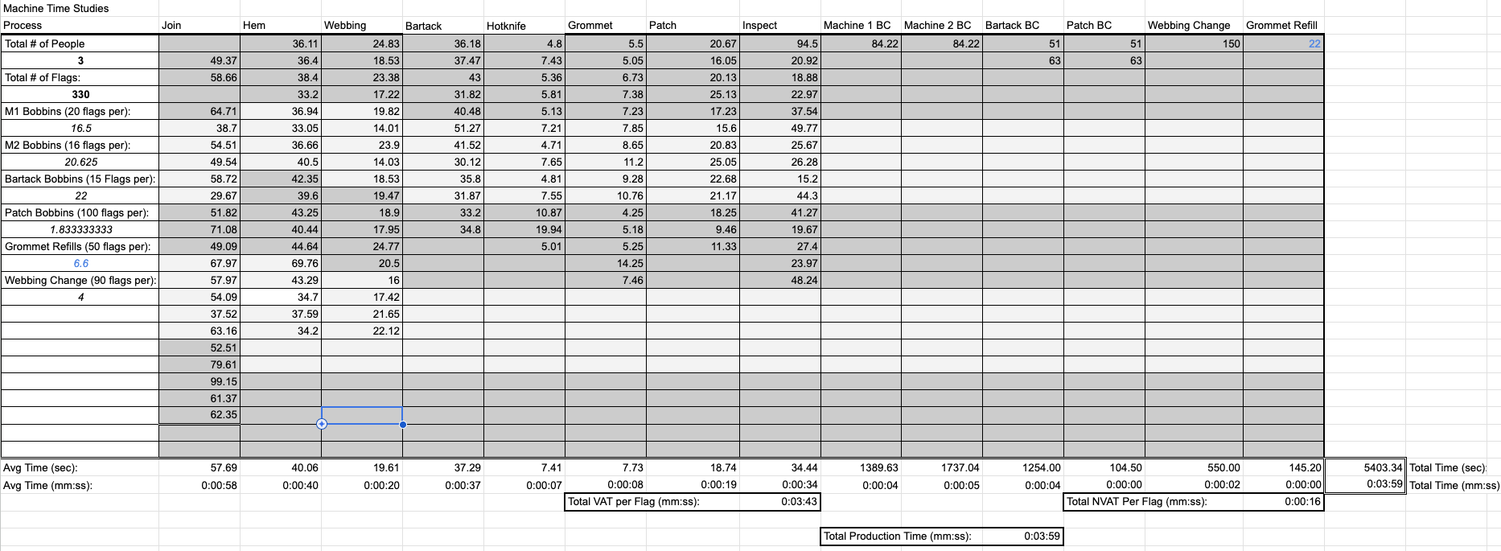
Time study data
We collected time study data including all of our necessary non value add time and loaded that information into ChatGPT to begin the exercise.

Slide 6
Prompt specificity
Be very specific with your prompts and include as much data as possible. This is an example that was used for this exercise:
I am evaluating a sewing production line. Below are the operations, cycle times, changeover times and available hours per shift.
  Join: 57.69 sec
  Hem: 40.06 sec
  Webbing: 19.61 sec
  Bartack: 37.29 sec
  Hot Knife: 7.41 sec
  Grommet: 7.73 sec
  Patch: 18.74 sec
  Inspect: 33.44 sec
My goal is to maximise throughput while minimizing labor and balancing the labor operations of the sewing line. The operations have to stay in this order but the floor layout can be adjusted in order to maximize efficiency.

Slide 7
Prompt specificity
Using the cycle times above, ignore the current floor layout.
Assume I want a 3-operator manufacturing cell.
Balance the workload across operators so each operator has approximately the same total cycle time.
You may assign non-sequential operations to the same operator if it reduces labor imbalance.
Show:
Operator assignments
Total seconds per operator
Variance from average
Why each grouping was selected

Slide 8
Results from prompts
Your cycle-time signature is very specific:
Join is a monster (57.69)
Hem and Bartack are heavy mids (40.06 & 37.29)
Inspect is substantial (33.44)
Webbing is light (19.61)
Patch is light-mid (18.74)
Grommet & Hot Knife are extremely light (7.7 & 7.4)
So the correct approach is:
Anchor each operator with one large step (Join, Hem, Bartack)
Then fill remaining capacity with lighter, logically compatible steps.
This yields the optimum balance

Slide 9
Results from prompts
Operator 1 – JOIN-CENTERED LOAD
Full load:
Join — 57.69
Grommet — 7.73
Hot Knife — 7.41
Total: 72.83 sec (PERFECT)
Why this works:
Join is massively heavy. The only way to balance it is to pair it with two ultra-fast steps — grommet and hot knife. This was exactly the breakthrough last time.
Operator 2 – HEM-CENTERED LOAD
Full load:
Hem — 40.06
Webbing — 19.61
Patch — 18.74
Total: 78.41 sec (dead-center for takt)
Why this works:
Hem is the second-heaviest operation. Pairing Hem + Webbing + Patch creates a beautifully centered workload (~78 sec). Most people try to put Webbing elsewhere, but mathematically this is the most stable build.
Operator 3 – BARTACK-CENTERED LOAD
Full load:
Bartack — 37.29
Inspect — 33.44
Total: 70.73 sec (near-perfect)
Why this works:
Bartack is heavy; inspect is heavy-mid. Together they land almost exactly on target. Importantly, inspect stays here because it finishes flow (customer-facing quality) and closes the U-shape efficiently.

Slide 10
Using ai to solve manufacturing problems
There are several key points to note when using AI to try to solve issues within a manufacturing facility.
Upload as much data as possible about your business before beginning to use AI as a problem solver. Any AI platform needs to be taught about your business model and manufacturing processes before it can be used as a tool.
Have real data that can be used for issues. We have been collecting time study data for years that we were able to upload into AI for interpretation.
Give clear direction about the intent of use. We were able to explain exactly what we were hoping to gain as we were giving the prompts.
Be open minded. The result that we received was not what we initially thought we were going to get. We were able to pivot to a completely different production model based on the results we received.
Do post mortem research. Just because AI said it, we still did a lot of research to ensure that the results given were based in fact and had proven case studies to validate the information.

Slide 11
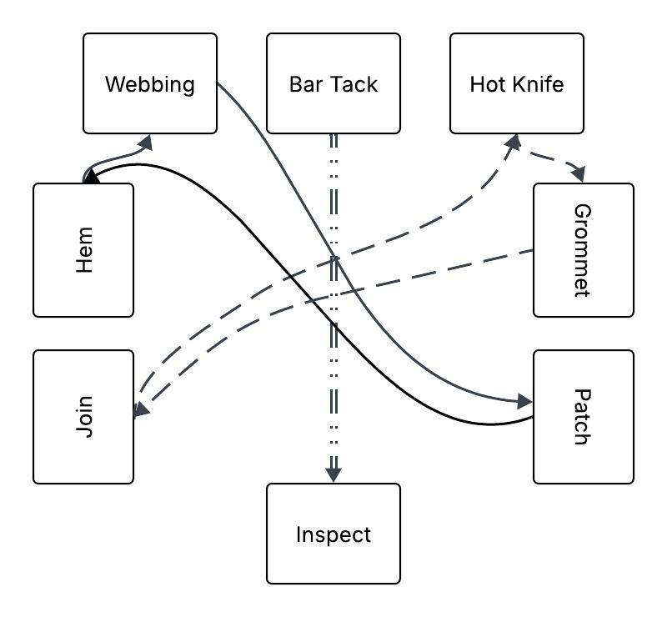
Final Iteration of production system
After several attempts at balancing our production line, we arrived at a “U” shaped design. This allowed the operators to share the workload more evenly. Here are the proposed new times:
Proposed cell design balances the workload of each operator to be ensure maximum usage of available time
Operator 1 performs Join/Hot Knife/Grommet
  Estimated total time per flag is 72.8 seconds
Operator 2 performs Hem/Webbing/Patch
  Estimated total time per flag is 78.41 seconds
Operator 3 performs Bar Tack/Inspect
  Estimated total time per flag is 70.73 Seconds
Estimated daily output increased from 300/day to 330-400/day for a 10%-30% increase in capacity.

Slide 12
Final results
Negligible capital investment to restructure lines
10-20% increase in production within the first 30 days after implementation
Operator feedback was positive across all lines
Gains have been sustained across all lines for 6 months
Confidence in using AI to solve complex manufacturing issues has been elevated

Slide 13
THANK YOU
Q&A

